Slide 1
AI breaks the Solow Model

Slide 2
I deliberately misspell “capital” as “kapital”
Because “capital” and “capita” look too similar.

Slide 3
The Solow growth model
Adopts a per-capita perspective.
Assumes kapital depreciates exponentially.
If you are familiar with Solow model, skip the next page

Slide 4
The Solow growth model
Per-capita kapital accumulation explains intensive economy growth.
Per-capita kapital scales up the output, but there is diminishing return. (1)
Assumes kapital depreciates exponentially. (2)
(1) + (2) yields an equilibrium (ceiling) for kapital accumulation. We cannot sit and enjoy intensive economy growth forever.
Technology and organization improvements lead to extensive growth.
Read more: https://www.pitt.edu/~mgahagan/Solow.htm
(The model gives many more important insights, such as the poverty trap. They are not relevant to my main point so they are not discussed here.)

Slide 5
The Solow model problem
The Solow model is used to explain why many developed countries today cannot grow as fast as they used to grow.
For example, it is generally believed that US is near the kapital accumulation ceiling. To keep growing, we very much count on technology innovations and institution improvements now.
Is that not a little stressful? If we are slow to innovate, the economy growth rate will be slower and slower. It can be a shock for the people used to high growth rates.

Slide 6
The Solow model problem
The development of AI (artificial intelligence) is traditionally thought of as technology innovation – one way of bringing extensive growth.
However, I want to show: the introduction of AI completely breaks the Solow model.

Slide 7
Using the Solow model to understand what AI will bring us

Slide 8
Growth ceiling exists only when both (1) and (2) are true
Per-capita kapital scales up the output, but there is diminishing return. (1)
Assumes kapital depreciates exponentially. (2)
Even when kapital depreciates exponentially, without diminishing return, an economy can still grow forever.
This can be shown via a Von Neumann economy simulation I did in 2019. https://github.com/Daniel-Chin/WageSim/blob/master/writeup/writeup.pdf

Slide 9
The essence of the paradox
One person can only manage so much kapital. (diminishing return)
If only another person could help…
But wait, if another person joins the picture, two mouths need to be fed. (per-capita perspective)

Slide 10
Diminishing return
Let us scrutinize the diminishing return effect.
Why does it exist?
What's so precious about a person that machines cannot replace?
It is General Intelligence!
But AIs don’t have General Intelligence (yet).
However, they don’t need to. They only need to approach it.

Slide 11
Diminishing return
For a person to manage more and more kapital, it will be harder and harder.
Not if machines can manage themselves!
Today, we surely try to let machines manage themselves. But there still needs to be a human overseer, for most systems.
As AI technologies develop, the degree of overseeing grows, i.e. the tree of management grows, with humans only at the top level, with all lower management handed over to AIs.
In this process, the return of kapital to labor essentially approaches a linear function.

Slide 12
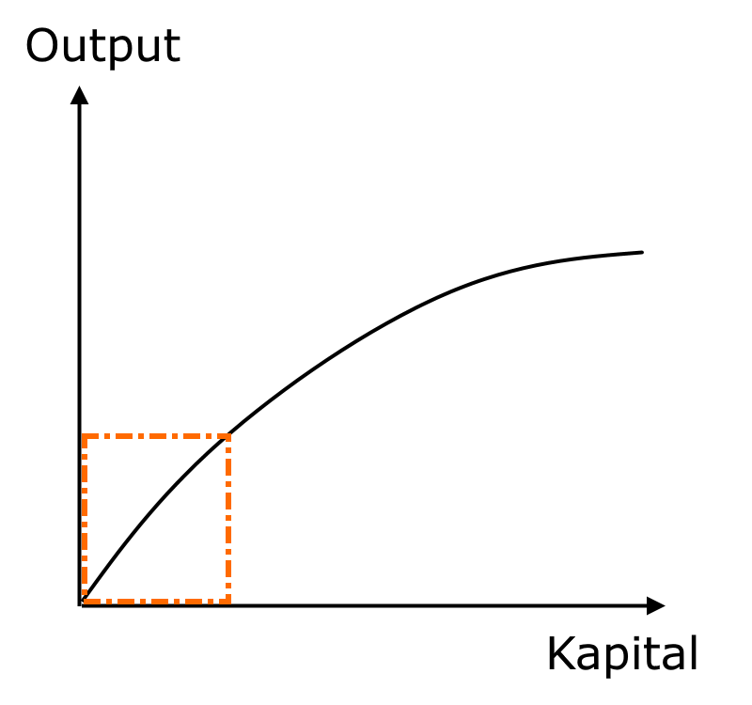
Employee
High-level AI
High-level AI
Low-level AI
Low-level AI
Low-level AI
Low-level AI

Slide 13
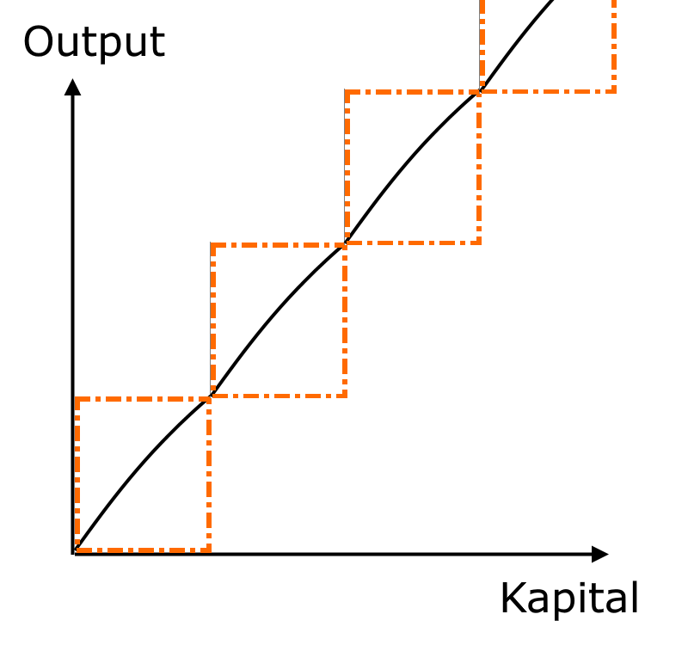
Employee

Slide 14
AI defeats the diminishing return
AI “lends a hand” without creating another “mouth to feed”.
The above point is trivial and well known, but it breaks how the Solow model manifests a growth ceiling. This point is especially clear under the per-capita perspective.
AI enables an economy to enjoy intensive growth indefinitely at constant rate. AI is not just a tech innovation. It brings a qualitative change.

Slide 15
The logic presented here must have tremendous limitations (ignoring natural resources; jumping to conclusions…). Hence I want to do further research.
Are you interested in supervising my research or some variations of it?
If you see any connection with any work you are currently doing, I am glad to hear about it!
Any comment or feedback on my thoughts will also be appreciated!
Daniel, Nov. 2020

